Slide 1
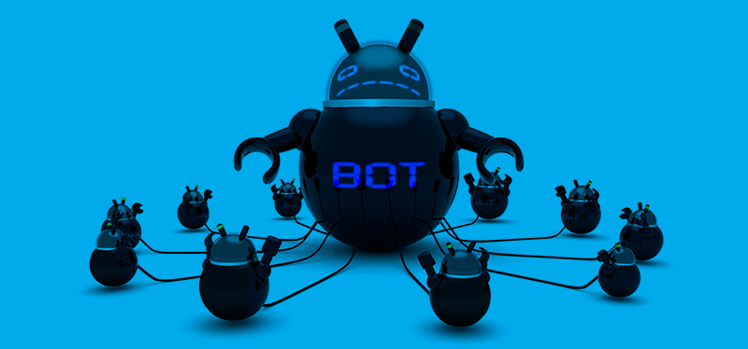
Botnet Detection in IoT Environment
By
Saeed Dhafer AlQahtani
18 Nov. 2021

Slide 2


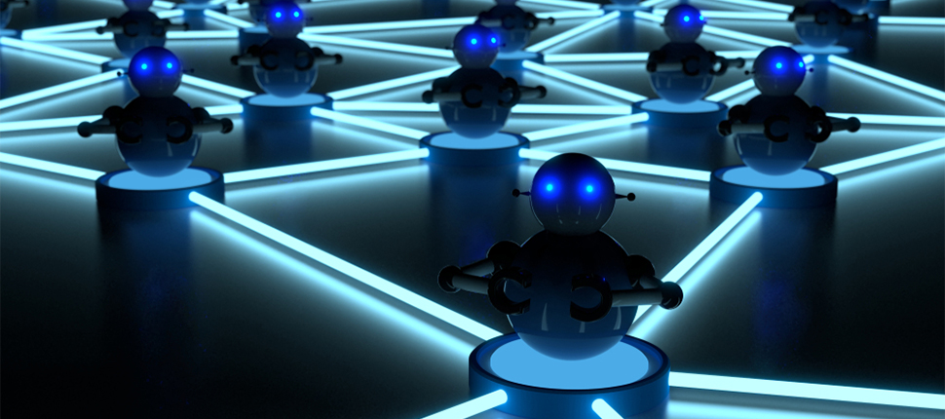
1
Introduction
The goal of this project is to use classification models for botnet detection in IoT environment in order to improve the IoT network security.

Slide 3
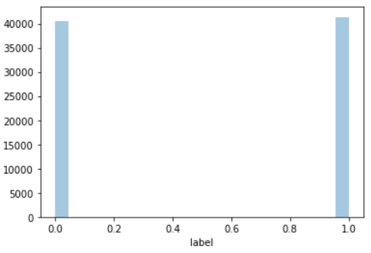

2
Dataset
More than 72 million records were captured to create BoT-IoT dataset.
The BoT-IoT dataset was created by designing a realistic network environment in the Cyber Range Lab of UNSW Canberra.
A size of 81789 records and 15 features were taken as balanced sample of the whole data to do the experiments.

Slide 4
3
Model Selection and Evaluation
I will implement a three machine learning methods:
Logistic Regression
Decision Trees
Random Forest
Model Evaluation
Accuracy
Precision
Recall
F1score
Feature importance ranking

Slide 5
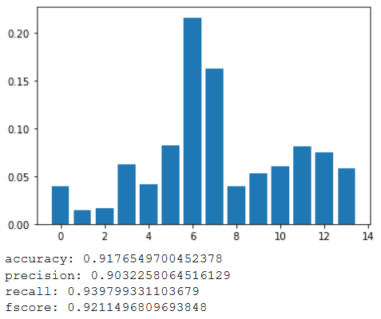
4
Conclusion
In this experiment, the RandomForest algorithm got the most accurate result among selected algorithms.

